Slide 1
HR Employee Attrition analysis & Prediction
CART, Random Forest and Neural Net

Slide 2
Objective
We have the employee data from an organization with 35 attributes.
The data is for 2940 employees of which 474 have been marked as atrites.
The objective is to predict Employee attrition rate using CART, Random Forest and Neural Net model.

Slide 3
The data in a nut shell
EmployeeNumber : int 1 2 3 4 5 6 7 8 9 10 ...
Age : int 41 49 37 33 27 32 59 30 38 36 ...
BusinessTravel : Factor w/ 3 levels "Non-Travel", "Travel_Frequently", .. : 3 2 3 2 3 2 3 3 2 3 ...
Attrition Factor w/ 2 levels "No","Yes": 2 1 2 1 1 1 1 1 1 1 ...
DailyRate : int 1102 279 1373 1392 591 1005 1324 1358 216 1299 ...
Department : Factor w/ 3 levels "Human Resources",..: 3 2 2 2 2 2 2 2 2 2 ...
DistanceFromHome : int 1 8 2 3 2 2 3 24 23 27 ...
Education : int 2 1 2 4 1 2 3 1 3 3 ...
EducationField : Factor w/ 6 levels "Human Resources",..: 2 2 5 2 4 2 4 2 2 4 ...
EmployeeCount : int 1 1 1 1 1 1 1 1 1 1 ...
EnvironmentSatisfaction : int 2 3 4 4 1 4 3 4 4 3 ...
Gender : Factor w/ 2 levels "Female","Male": 1 2 2 1 2 2 1 2 2 2 ...
HourlyRate : int 94 61 92 56 40 79 81 67 44 94 ...
JobInvolvement : int 3 2 2 3 3 3 4 3 2 3 ...
JobLevel : int 2 2 1 1 1 1 1 1 3 2 ...
JobRole : Factor w/ 9 levels "Healthcare Representative",..: 8 7 3 7 3 3 3 3 5 1 ...
JobSatisfaction : int 4 2 3 3 2 4 1 3 3 3 ...
MaritalStatus : Factor w/ 3 levels "Divorced","Married",..: 3 2 3 2 2 3 2 1 3 2 ...
MonthlyIncome : int 5993 5130 2090 2909 3468 3068 2670 2693 9526 5237 ...
MonthlyRate : int 19479 24907 2396 23159 16632 11864 9964 13335 8787 16577 ...
NumCompaniesWorked : int 8 1 6 1 9 0 4 1 0 6 ...
Over18 : Factor w/ 1 level "Y": 1 1 1 1 1 1 1 1 1 1 ...
OverTime : Factor w/ 2 levels "No","Yes": 2 1 2 2 1 1 2 1 1 1 ...
PercentSalaryHike : int 11 23 15 11 12 13 20 22 21 13 ...
PerformanceRating : int 3 4 3 3 3 3 4 4 4 3 ...
RelationshipSatisfaction: int 1 4 2 3 4 3 1 2 2 2 ...
StandardHours : int 80 80 80 80 80 80 80 80 80 80 ...
StockOptionLevel : int 0 1 0 0 1 0 3 1 0 2 ...
TotalWorkingYears : int 8 10 7 8 6 8 12 1 10 17 ...
TrainingTimesLastYear : int 0 3 3 3 3 2 3 2 2 3 ...
WorkLifeBalance : int 1 3 3 3 3 2 2 3 3 2 ...
YearsAtCompany : int 6 10 0 8 2 7 1 1 9 7 ...
YearsInCurrentRole : int 4 7 0 7 2 7 0 0 7 7 ...
YearsSinceLastPromotion : int 0 1 0 3 2 3 0 0 1 7 ...
YearsWithCurrManager : int 5 7 0 0 2 6 0 0 8 7 ...
Of the 35 variables available, the following variables will not add any value to the analysis
EmployeeNumber – As its just a unique number per employee
Over18 – As all employees are over 18
StandardHours – As they are same for all employees
EmployeeCount – As it’s a constant for all employees

Slide 4
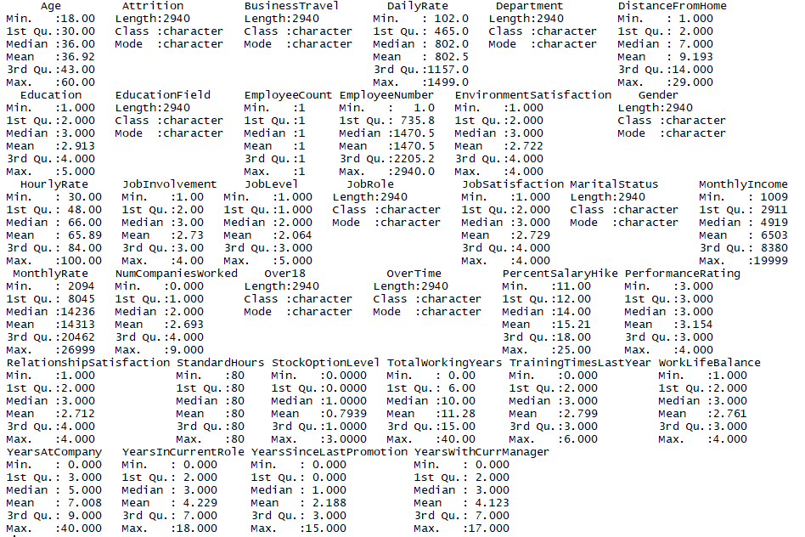
Five number summary of data:

Slide 5
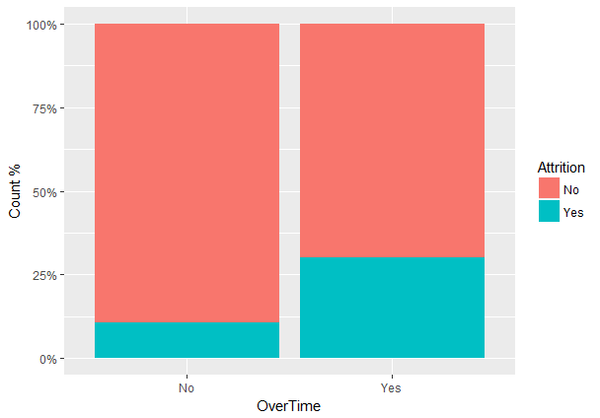
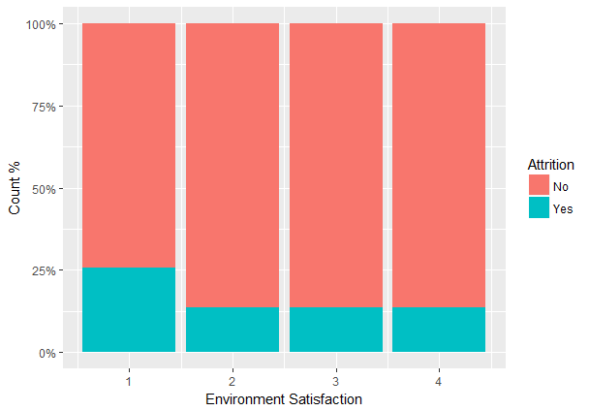
Exploratory Data Analysis
The graph shows that employees doing overtime are more likely to attrite.
When the environment satisfaction is very low, the attrition is high. As the environment gets a little better, the attrition drops by half. However it then becomes independent of the environment.

Slide 6
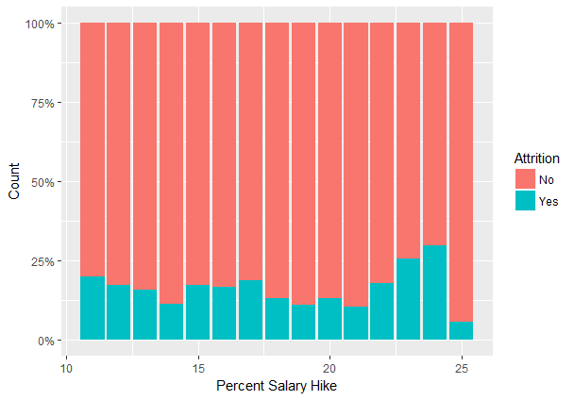
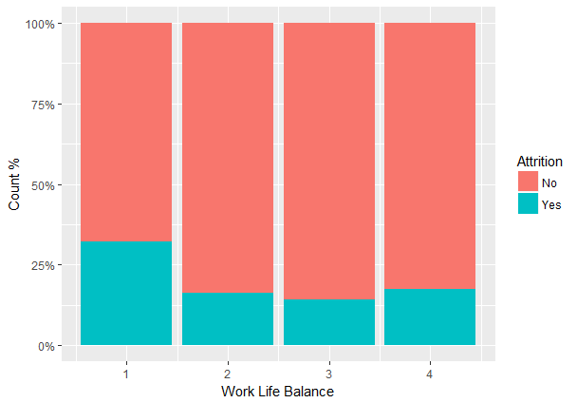
Exploratory Data Analysis
Surprisingly the attrition is not much influenced by salary hike. In fact it seems a little higher for employees with salary hike above 22%
Employees with lower work life balance are more likely to attrite, which is expected.
There is a marginally higher attrition for those with the best work-life balance. Is the balance too much tilted?

Slide 7
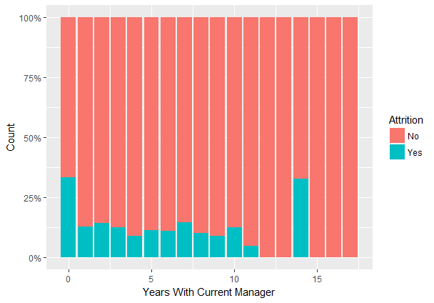
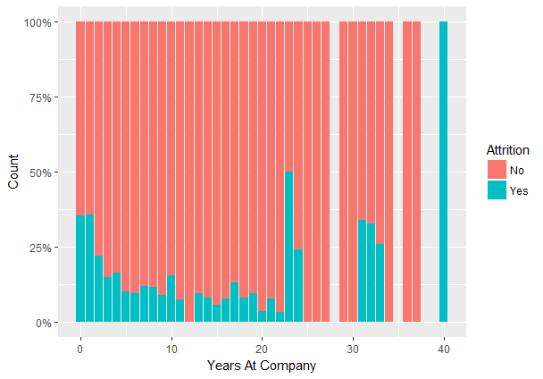
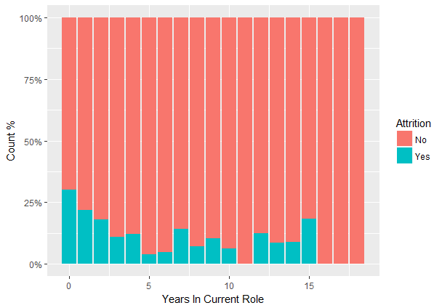
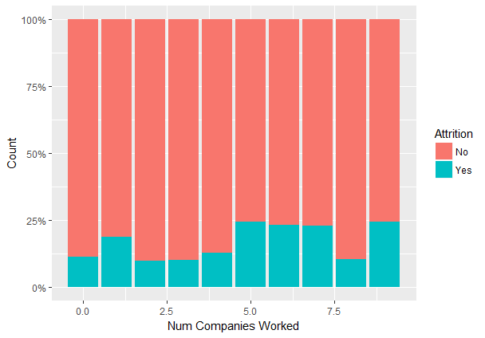
EDA - Tenure
The first year with a new manager is crucial. That’s when most attritions happen.
Attrition is higher at the early stage in the company or post 22 yrs at the company. It is the lowest between 10 and 22 years.
The graph shows that employees are more likely to attrite just after a role change. Possibly moving to a new manager.
There’s also an attrition possibility when employees stay too long (10+ yrs) in the same role.
Attrition is higher if the employee is a lateral and has worked in 5+ other companies before joining this company

Slide 8
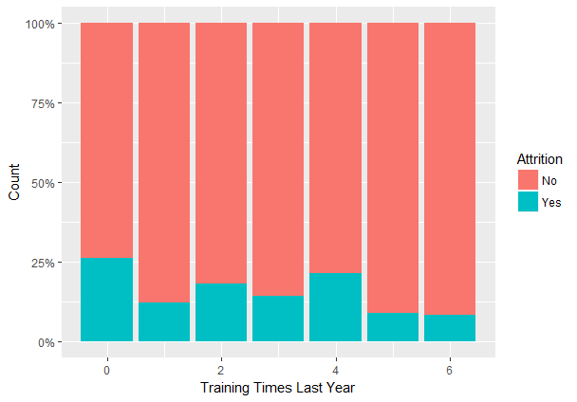
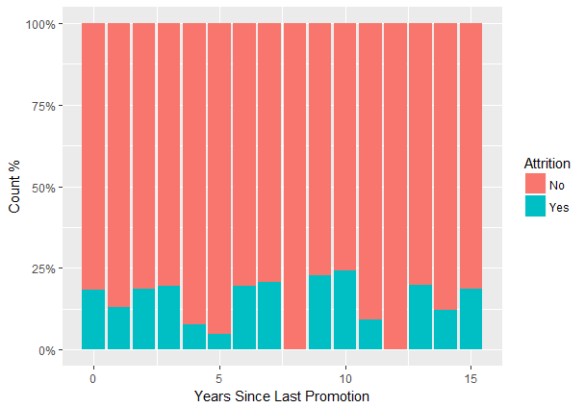
EDA – Training & Promotion
Those not undergoing any training in the previous 12 moths are more likely to attrite.
Attrition percentage is dropping every 4 years, possibly because the associates are getting some promotion.

Slide 9
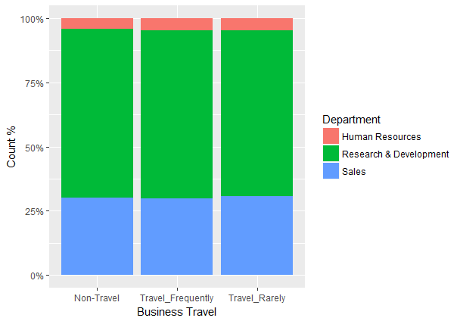
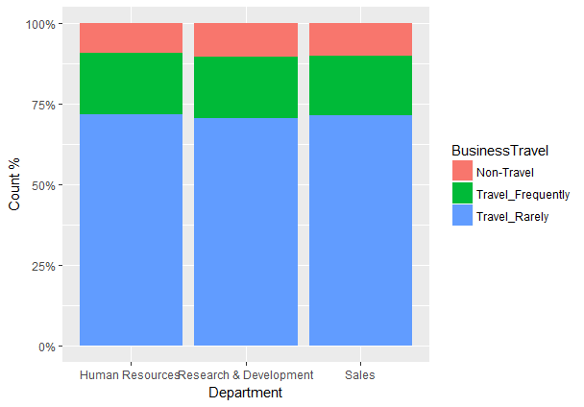
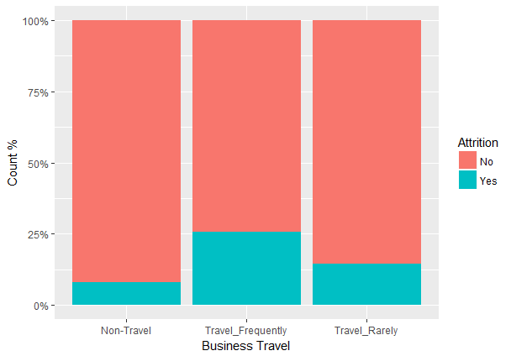
EDA – Travel pattern
The split of employees across different travel frequencies was same across departments. The travel pattern of employees across departments was also very similar.
Those traveling frequently were more likely to quit.

Slide 10
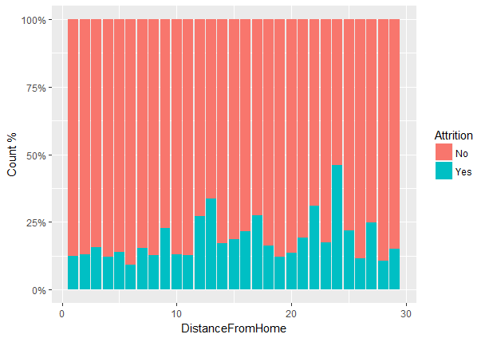
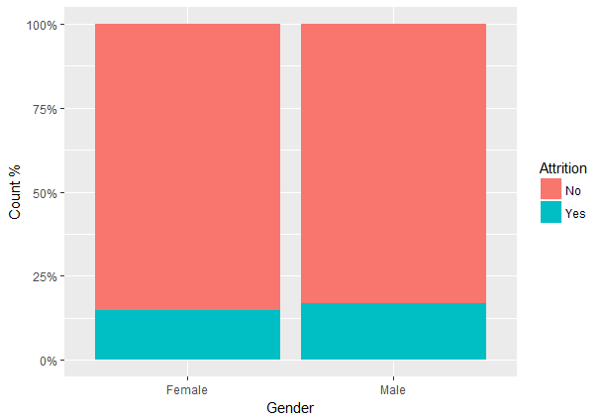
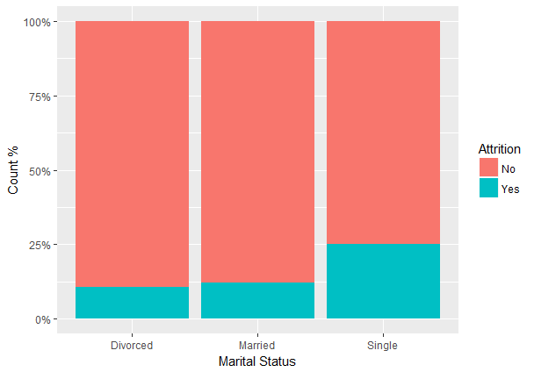
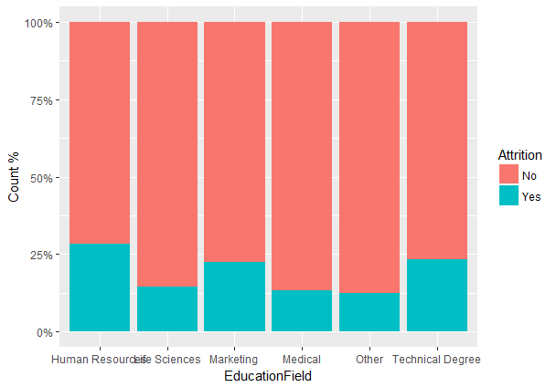
EDA – Personal Info
Distance from Home or Gender does not seem to influence the Attrition
Attrition is higher in Single individuals than those who are married or divorced.
Attrition is higher in employees with HR, Marketing or Technical degrees.

Slide 11
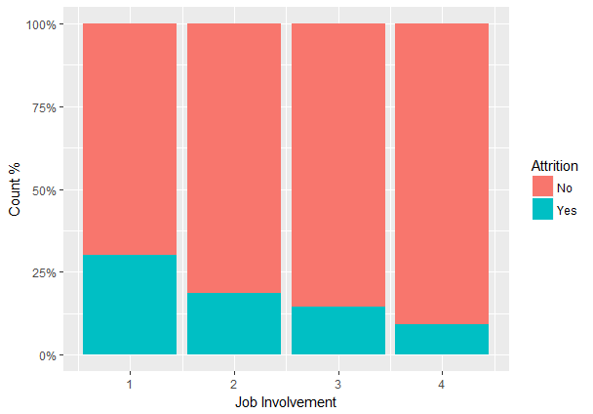
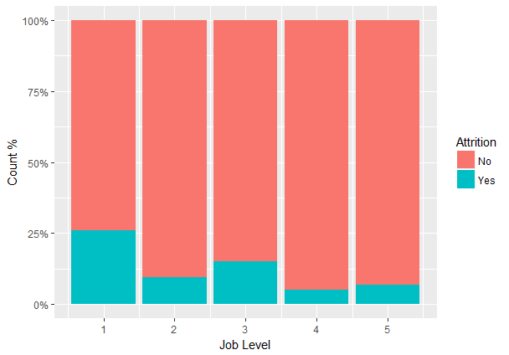
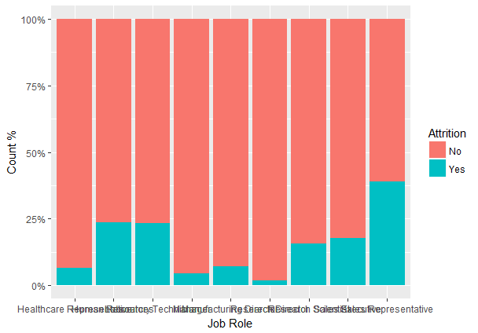
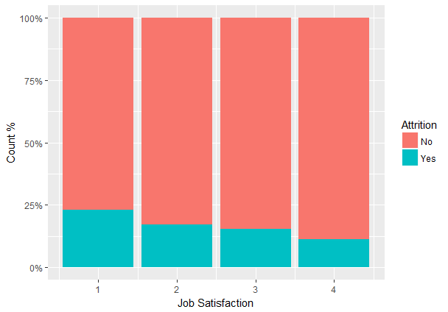
EDA – Job info
Attrition is higher in employees with low Job Involvement and Low Job Satisfaction.
Those with Job Level 1 & 3 are more likely to quit
Those in Job roles of Healthcare Representative, Manager, Mfg Director and Research Director are less likely to quit

Slide 12
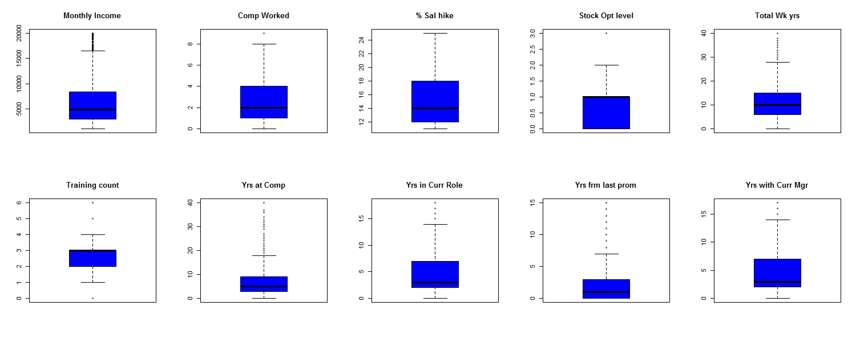
Box plot for few variables with possible outliers
The frequency distribution shows a few outliers. However for further analysis the full data is considered.

Slide 13
Predictive Models

Slide 14
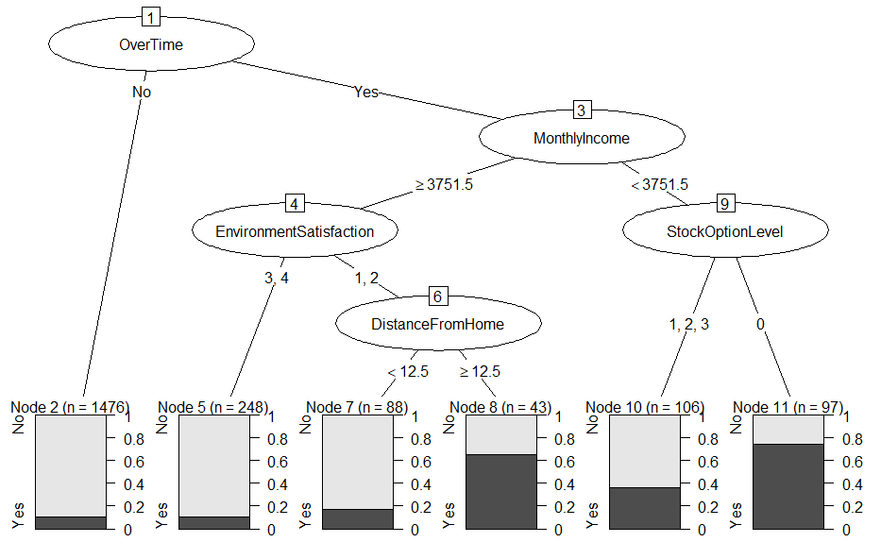
CART Model with minsplit = 60, minbucket = 30 and depth=6

Slide 15
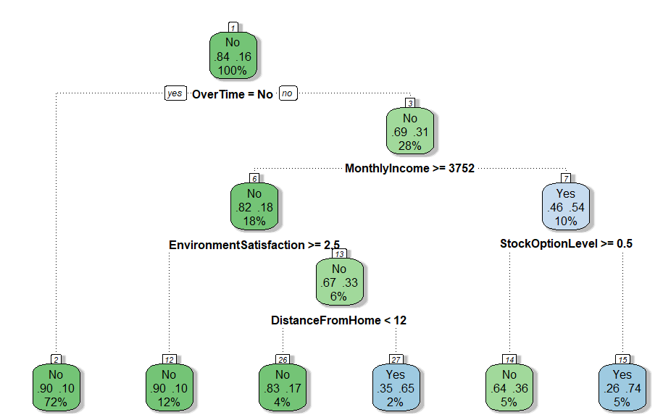
CART Model with minsplit = 60, minbucket = 30 and depth=6

Slide 16
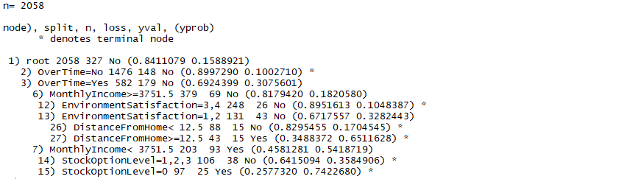
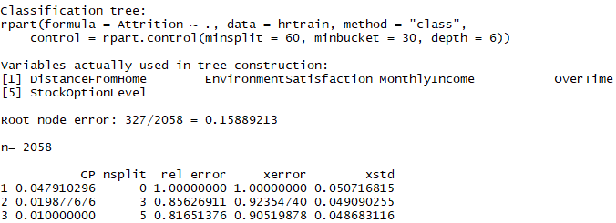
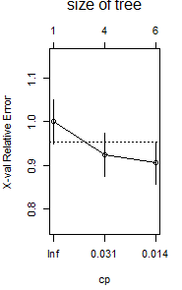


Brief summary from CART model

Slide 17


CART Model deciles on validation sample
Confusion Matrix

Slide 18
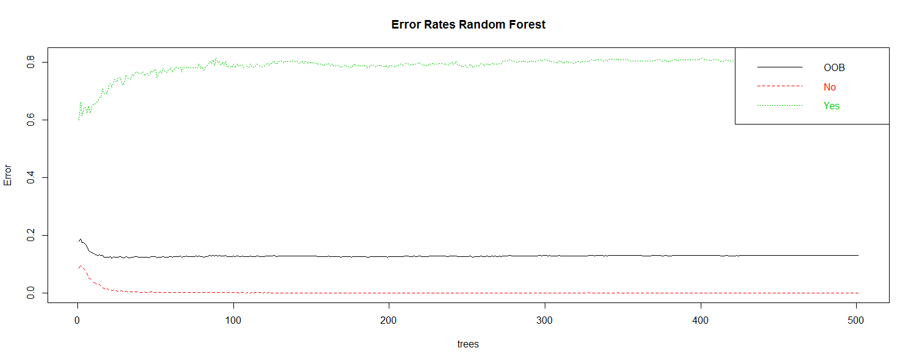
Random Forest Error Rates

Slide 19
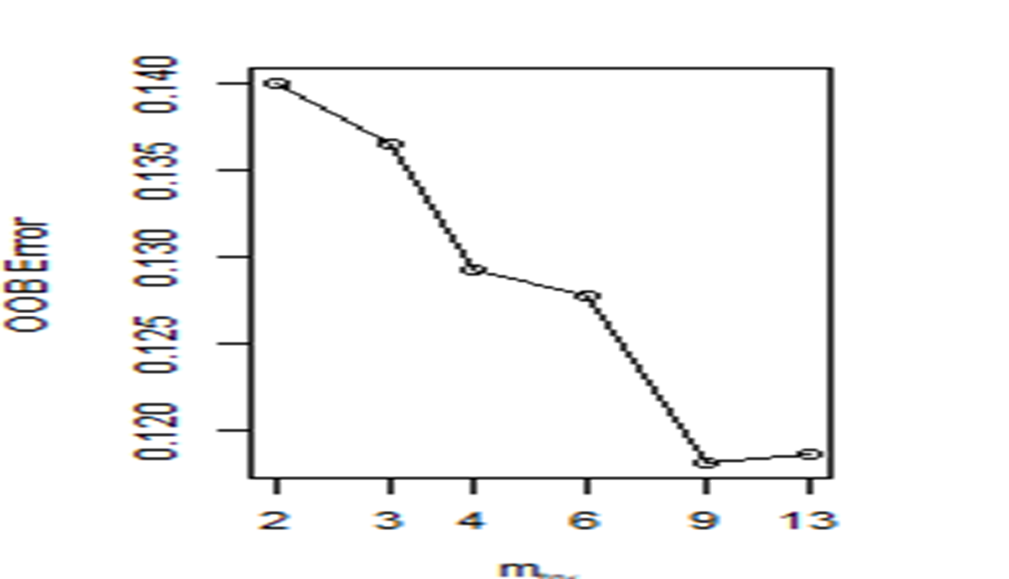
Tuning the Random Forest

Slide 20
Decile Table for dev data
 | deciles | cnt | cnt_yes | cnt_no | rrate | cum_yes | cum_no | cum_rel_yes | cum_rel_no | ks
1 | 10 | 207 | 207 | 0 | 100.00 | 207 | 0 | 0.63 | 0.00 | 207.00
2 | 9 | 205 | 115 | 90 | 56.10 | 322 | 90 | 0.98 | 0.05 | 321.95
3 | 8 | 213 | 6 | 207 | 2.82 | 328 | 297 | 0.99 | 0.17 | 327.83
4 | 7 | 211 | 2 | 209 | 0.95 | 330 | 506 | 1.00 | 0.29 | 329.71
5 | 6 | 196 | 0 | 196 | 0.00 | 330 | 702 | 1.00 | 0.41 | 329.59
6 | 5 | 218 | 0 | 218 | 0.00 | 330 | 920 | 1.00 | 0.53 | 329.47
7 | 4 | 199 | 0 | 199 | 0.00 | 330 | 1119 | 1.00 | 0.65 | 329.35
8 | 3 | 245 | 0 | 245 | 0.00 | 330 | 1364 | 1.00 | 0.79 | 329.21
9 | 2 | 216 | 0 | 216 | 0.00 | 330 | 1580 | 1.00 | 0.91 | 329.09
10 | 1 | 148 | 0 | 148 | 0.00 | 330 | 1728 | 1.00 | 1.00 | 329.00

Slide 21
Decile table for validation set
 | deciles | cnt | cnt_yes | cnt_no | rrate | cum_yes | cum_no | cum_rel_yes | cum_rel_no | ks
1 | 10 | 89 | 84 | 5 | 94.38 | 84 | 5 | 0.58 | 0.01 | 83.99
2 | 9 | 88 | 41 | 47 | 46.59 | 125 | 52 | 0.87 | 0.07 | 124.93
3 | 8 | 88 | 6 | 82 | 6.82 | 131 | 134 | 0.91 | 0.18 | 130.82
4 | 7 | 99 | 11 | 88 | 11.11 | 142 | 222 | 0.99 | 0.30 | 141.70
5 | 6 | 80 | 0 | 80 | 0.00 | 142 | 302 | 0.99 | 0.41 | 141.59
6 | 5 | 93 | 2 | 91 | 2.15 | 144 | 393 | 1.00 | 0.53 | 143.47
7 | 4 | 81 | 0 | 81 | 0.00 | 144 | 474 | 1.00 | 0.64 | 143.36
8 | 3 | 93 | 0 | 93 | 0.00 | 144 | 567 | 1.00 | 0.77 | 143.23
9 | 2 | 88 | 0 | 88 | 0.00 | 144 | 655 | 1.00 | 0.89 | 143.11
10 | 1 | 83 | 0 | 83 | 0.00 | 144 | 738 | 1.00 | 1.00 | 143.00

Slide 22
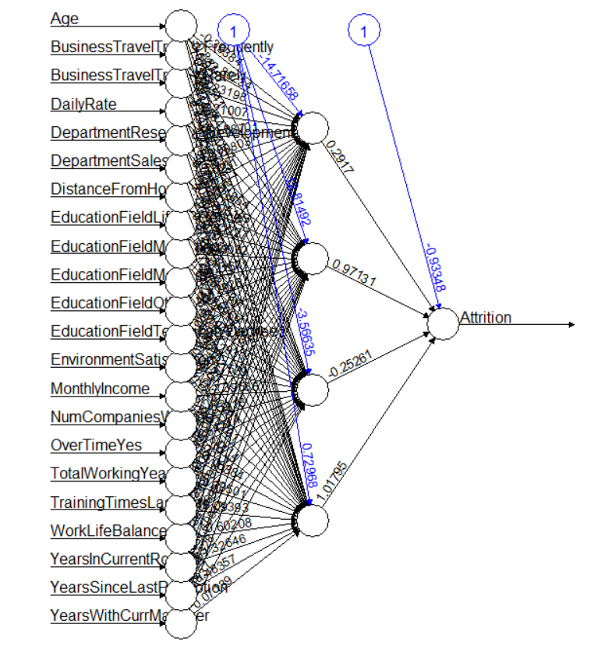
Neuralnet plot

Slide 23
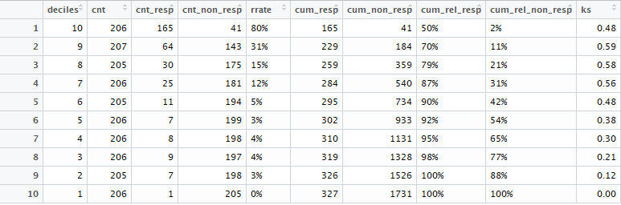
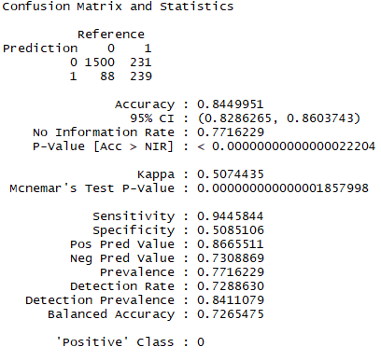
Decile table & Confusion matrix for dev data (neuralnet)

Slide 24
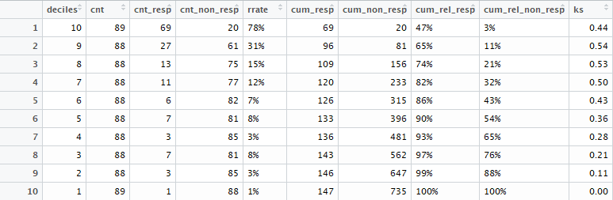
Decile table for validation set (neuralnet)

Slide 25
Final take-away
Comparing decile table of all 3 model , neural network model seems to be good after scaling the data .
Neural net model has a good accuracy as it’s considering all the input variables
Decision tree based model will be faster compared to neural net model as it rules out certain input variables from considering based on internal greedy algorithm.
Decision tree based model is also good but need to take care of pruning the tree and over fitting of the model.

